Slide 1

Project Stage – I
“SIH-1710: Enhancing Navigation for Railway Station Facilities and Locations”
By
1. Harshal Vishnubhagwan Gaikwad (221106020)
2. Nomesh Ravindra Kirange(221106022)
3. Mrunali Ravindra Badgujar(231206001)
4. Tejas Rajendra Jadhav(221106037)
Under the Guidance of
Prof. S. P. Salunkhe
Department of Computer Science and Engineering(Data Science)
The Shirpur Education Society’s
R. C. Patel Institute of Technology, Shirpur - 425405.
[2024-25]

Slide 2

Outline
Outline
Introduction
Project Objectives
Existing System survey
Literature Survey
Software Requirement
System Design (Flow of the Project)
Implementation Phase I
Conclusion

Slide 3
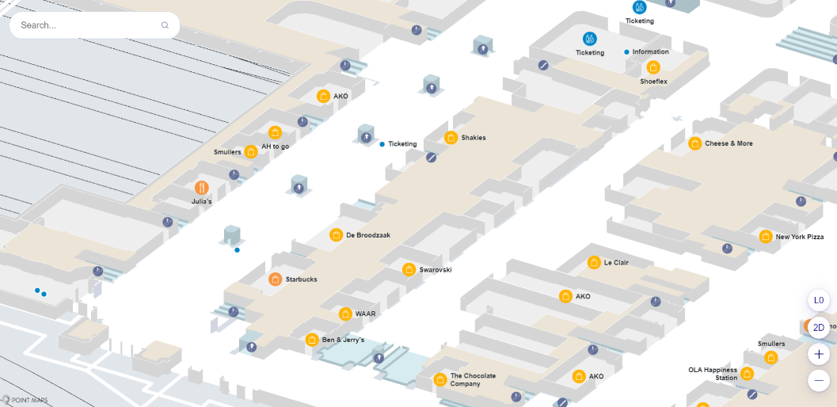
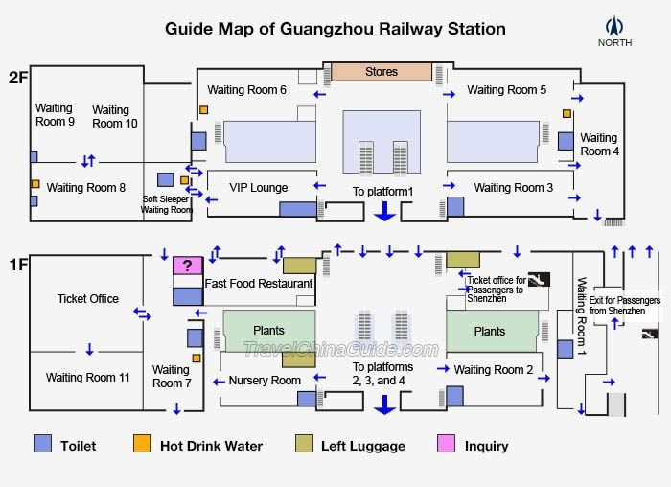
Introduction
Railway stations are large and complex, making navigation difficult.
Existing methods like static maps and signboards are inefficient.
Augmented Reality (AR) can provide real-time indoor navigation.
Our solution uses ARCore for real-time path guidance.

Slide 4
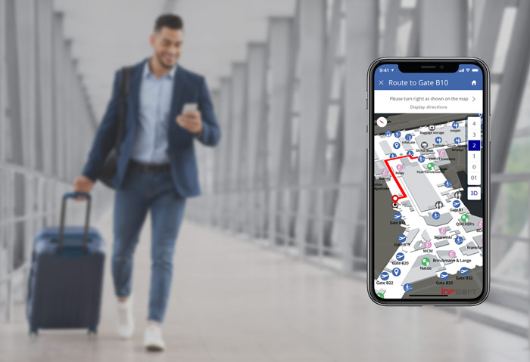
Project Objectives
✅ Develop an AR-based navigation system for railway stations.
✅ Implement ARCore for real-time mapping.
✅ Store navigation data dynamically in Firebase.
✅ Use A* Algorithm for shortest path computation.
✅ Provide an intuitive user experience using Figma.

Slide 5
Existing System survey
System | Country/Area | Technology Used | Limitations
Tokyo Metro AR App | Japan | AR Navigation for metro stations | Limited to metro, no real-time updates
Indoor Google Maps | USA, Europe, Japan | GPS, WiFi positioning | Requires pre-mapped locations, limited customization
Navilens (For visually impaired users) | Spain | QR Code-Based Navigation | Requires pre-installed QR markers

Slide 6
Literature Survey
"Augmented Reality for Indoor Navigation" – Discusses the potential of AR in large transport hubs.
"AI-Powered Navigation for Smart Cities" – Highlights the role of machine learning in optimizing routes.
"Comparison of Indoor Positioning Systems" – Reviews GPS, WiFi, and AR-based navigation approaches.
"Enhancing Accessibility Through AR Navigation" – Focuses on AR applications for visually impaired passengers.

Slide 7
Criteria | Firebase ✅ | Supabase | AWS Amplify | Appwrite | Backendless
Real-time Sync | Built-in via Firestore | Yes (limited scale) | Yes (via AppSync) | Limited | Yes
Location-Based Queries | Geoqueries via Firestore + GeoFire | Custom setup | Requires AWS Location | Manual + SQL | Built-in GeoLocation
Offline Support | Excellent (Web + Mobile) | Partial (client-driven) | Limited (client cache) | Limited | Yes
AR SDK Integration | Easy with Google ARCore & Unity SDKs | No official SDKs | AWS + 3rd party needed | No official support | No native AR SDKs
Hosting & CI/CD | Firebase Hosting + CLI | Basic, or external | Amplify Hosting + CI/CD | Manual Docker deploy | Hosting included (custom)
Authentication | Easy setup + social logins | Good (OAuth, magic) | AWS Cognito (complex) | Decent (custom JWTs) | Yes (custom logic)
Serverless Functions | Cloud Functions (auto-scale) | Edge Functions (Deno) | AWS Lambda (complex) | Node.js (manual scaling) | Codeless or JS functions
Scalability | Google Cloud-backed | Postgres limits | Enterprise-ready | Needs manual scaling | Cloud & limited scale
Ease of Setup & Dev | Very fast + Docs | Moderate (DevOps needed) | AWS CLI learning curve | Docker & manual config | Easy (but vendor-specific)
Free Tier / Cost Control | Generous Free Tier | Free but limited | Complex pricing model | Free, but infra cost | Free + pay-as-you-go
Mobile SDKs & AR Focus | Native SDKs for Android/iOS | Lacks mobile focus | Mobile SDKs via AWS | Limited | Mobile SDKs available

Slide 8
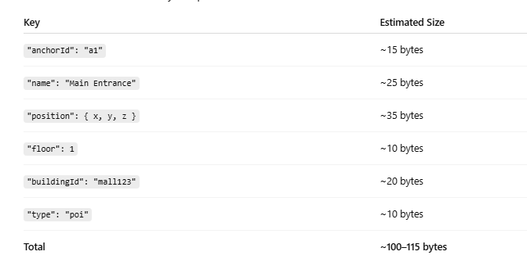
Example of Storing one anchor point

Slide 9
Hardware & Software Requirements
✅ Hardware:
ARCore-supported smartphones 📱
Stable internet connection 🌐
✅ Software:
Android Studio (Java) – App development 🛠️
Firebase – Cloud database for storing station maps & user data ☁️
Google ARCore – AR-based navigation framework 🏛️

Slide 10
System Design (Flow of the Project)
1] Mapping (Admin Mode)
Detect station surfaces using ARCore.
Drop AR anchors at key locations (platforms, exits, ticket counters).
Log paths & generate a navigation graph.
Store the map data in Firebase.

Slide 11
System Design (Flow of the Project)
2] User Navigation Mode
Fetch stored maps from Firebase.
User selects destination.
Compute the shortest route using A* Pathfinding Algorithm.
Overlay AR navigation guides on the camera view.
Adjust navigation dynamically if the user deviates.

Slide 12
Implementation of Phase 1

Slide 13
References
1️⃣ Google ARCore – Developer Guide 🔗 https://developers.google.com/ar
2️⃣ Firebase – Cloud Database Documentation 🔗 https://firebase.google.com/docs
3️⃣ A Pathfinding Algorithm Explanation* 🔗 https://theory.stanford.edu/~amitp/GameProgramming/AStarComparison.html
4️⃣ Indoor Navigation Research Paper (Example Study) 🔗 https://www.researchgate.net/publication/329703408_Indoor_Navigation_Systems
5️⃣ Android Studio Documentation 🔗 https://developer.android.com/studio

Slide 14
Conclusion
A well-designed railway station navigation system is crucial for enhancing passenger experience by providing clear, accessible, and real-time information, minimizing confusion and delays, especially in large, complex stations.

Slide 15
Thank You

Slide 17
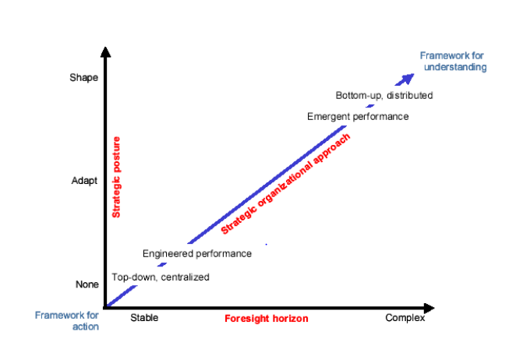

Slide 18
For Title – font Times new roman Size -36
For Normal text - font Times new roman Size -24
For Figure name – Font Times new roman Size -22
Note : (Continue same format and slide for remaining presentation slides)

